Slide 1
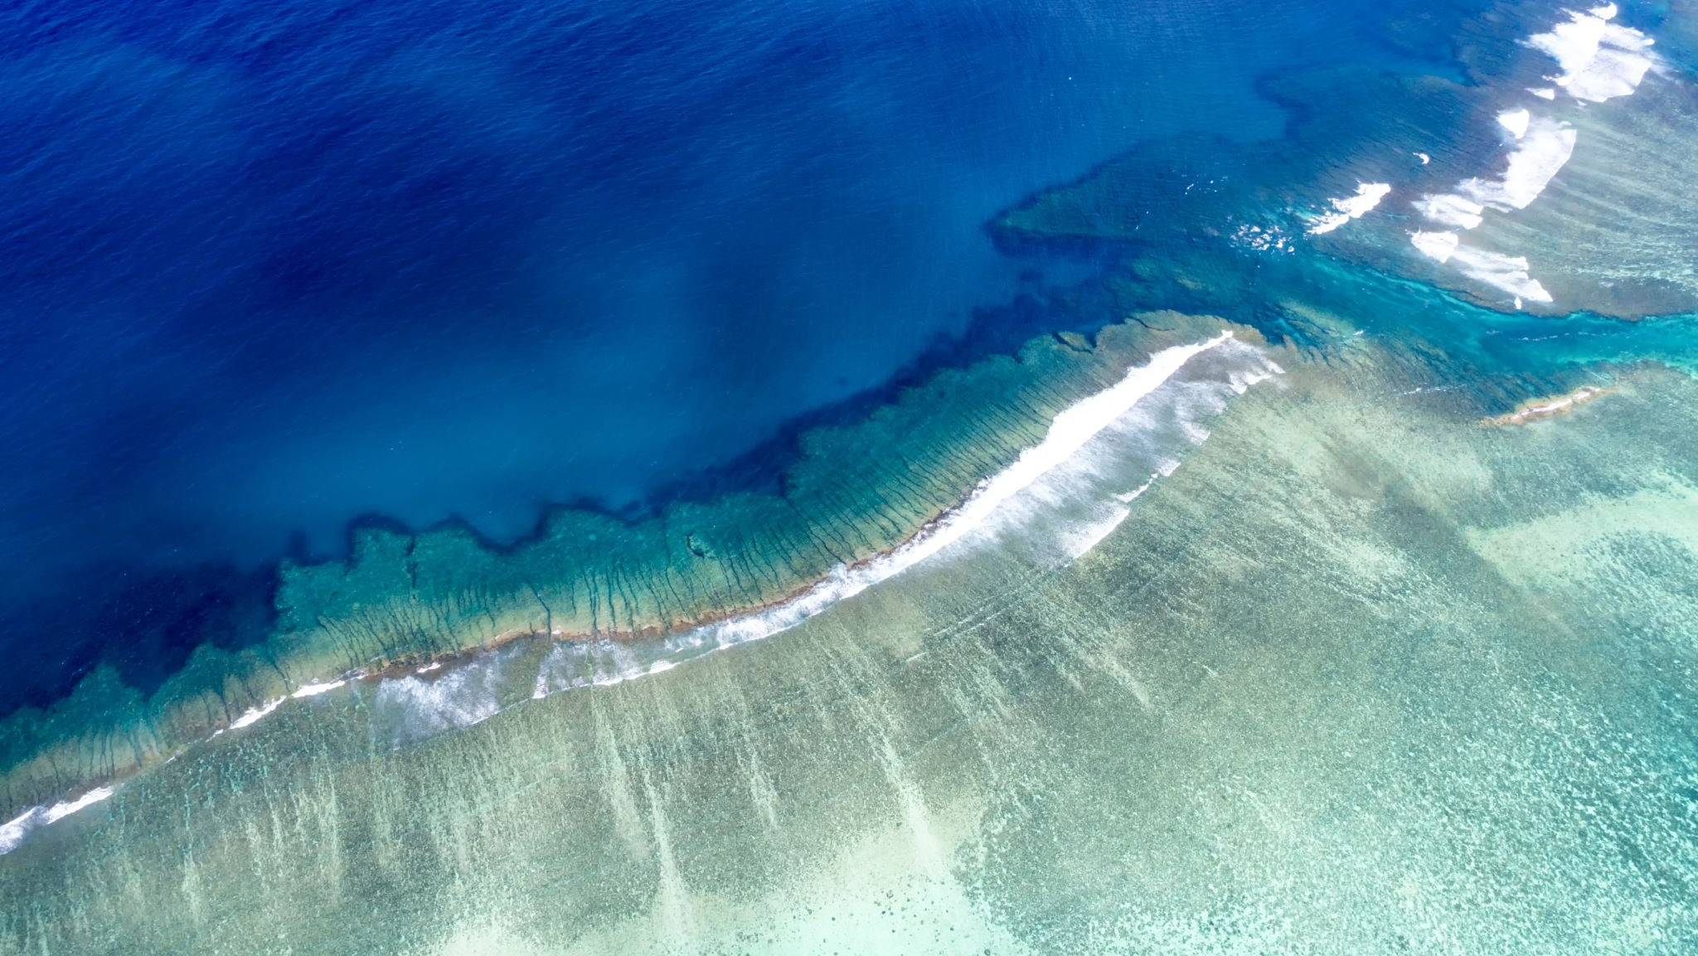

Nassau, bahamas
Aaron Padam & Nino Orton-Clarke

Slide 2
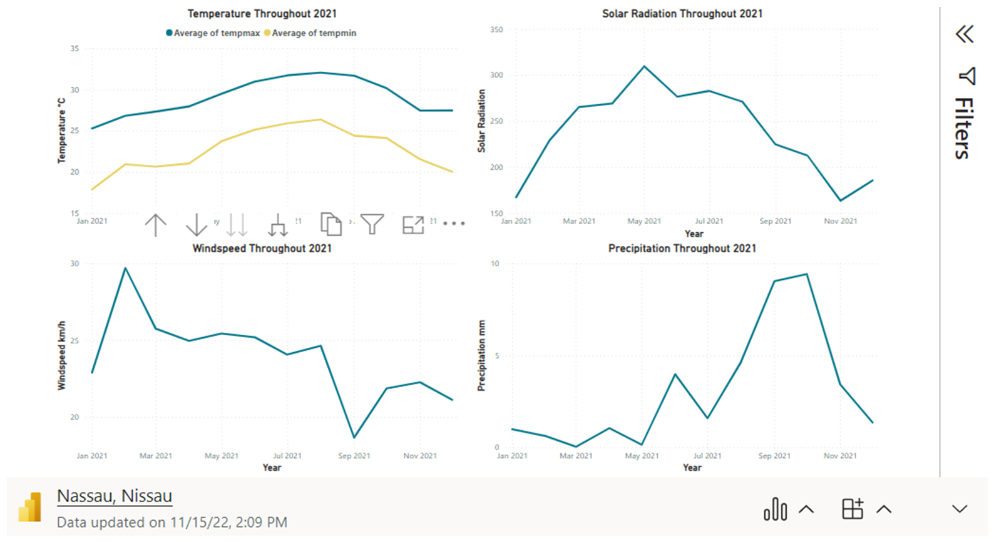
DATA

Slide 3

Golf
Courses:
Royal Blue Golf Club
Abaco Golf Club
Albany Golf Club
Ocean Golf Club
All 18-hole courses

Slide 4
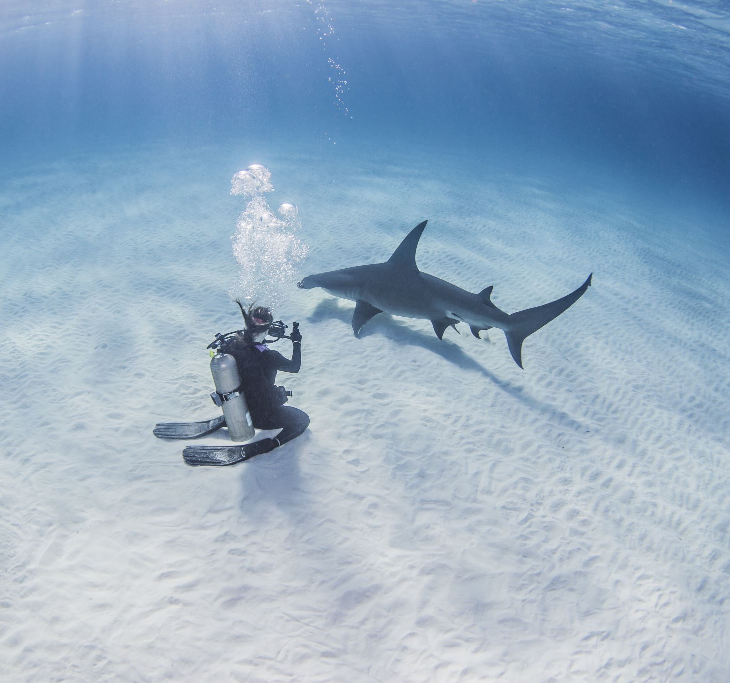
Scuba diving
Four Day Dive Package:
$539 per person
3-hour long diving sessions
Shallow reef, movie site or wreck dive
Beautiful reefs each with different coral formations and fish life

Slide 5

Flights
Houston - Nassau:
15-22 Dec this year - 7 days and 7 nights
$517 return flights
Self-transfer at MIA on both legs

Slide 6
hotel

Slide 7
Thanks for listening

